Slide 1
Relations and Digraphs
Lecture 4
Discrete Mathematical Structures

Slide 2
At the Last Class …
Part I: Basics of Combinatorics
  Permutations
  Combinations
  Pigeonhole principles
Part II: Some Techniques for Analysis
  Elements of probability
  Recurrence relations

Slide 3
Relations and Digraphs
Part I: Relations and Digraphs
  Product sets and partitions
  Binary relations and their digraphic form
  Paths in relations
  Representing relations
Part II: Equivalence Relation
  Properties of relations
  Equivalence relations and equivalence classes
  Equivalence relations and partitions

Slide 4
Ordered Pair and Cartesian Product
For any sets A,B
A×B = {(a,b)|a∈A, b∈B}
is called Cartesian Product of A and B
Example：
{1,2,3}×{a,b} = {(1,a), (2,a), (3,a), (1,b),(2,b), (3,b)}
For finite A，B， |A×B|= |A|×|B|

Slide 5

Generalized Cartesian Product
Cartesian product of m nonempty sets:
  A₁×A₂×...×A_{m}={(a₁,a₂,...,a_{m}) |a_{i}∈A_{i},i=1,2...,m }
Describing the attributes of objects using Cartesian product:
A computer program can be characterized by 3 attributes:
Language={C(c), Java(j), Fortran(f), Pascal(p), Lisp(l)}
Memory={2 meg(2), 4 meg(4), 8 meg(8)}
OS={UNIX(u), Windows(w), Linus(l)}
Then, any object in Language×Memory×OS can be assigned to a specific program to characterized it.

Slide 6
Properties of Cartesian Product
A×φ=φ×A=φ
A×B=B×A⇔A=B ∨ A=φ ∨ B=φ
  :Proof
  ⇐ Note that for any set S,
  S×φ={(x,y)|x∈S,y∈φ}, since no such y exists, so A×φ=φ, and φ×S=φ as well.
  ⇒ If A≠B and A≠φ, we can prove that B=φ by contradiction.
  Assume that B≠φ, since A≠B, let a∈A, but a∉B; let b is any element in B(may be in A or not), then (a,b)∈A×B, but (a,b)∉B×A, contradiction.

Slide 7
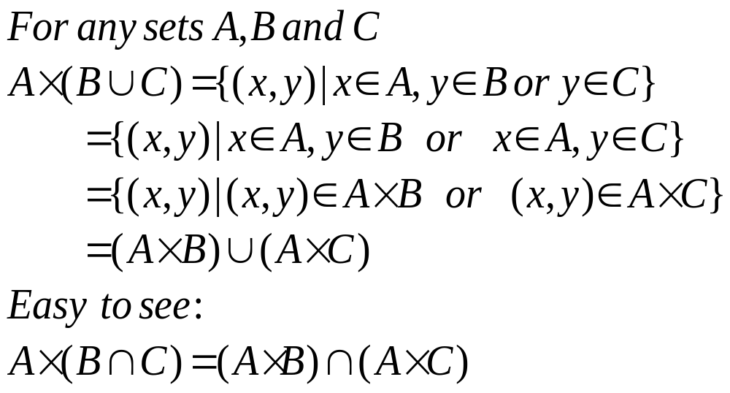
Properties of Cartesian Product
These are called the first distribution laws

Slide 8
Relation as a Set
Let A and B be nonempty sets. A relation R from A to B is a subset of A×B.
  If a∈A, b∈B, then “a is related to b by R” is written as:
  (a,b)∈R, or, aRb
R is a relation on A, if R⊆A×A

Slide 9
Some Relations as Examples
A={1,2,3}, B={r,s}, R={(1,r),(2,s),(3,r)}, then R is a relation from A to B.
A={1,2,3,4}, R={(1,1),(1,2),(1,3),(1,4),(2,2),(2,3),(2,4),
(3,3),(3,4),(4,4)}
then R is a relation on A, i.e. not larger than.
N is the set of all natural numbers (starting from 1), defining a relation R on N, such that, for any m,n∈N, (m,n)∈R if and only if m divides n. So, R⊆N×N, and R contains (3,6), (5,25), (7,21), etc.

Slide 10
Special Binary Relations
Empty relation on (any) set A.
  It is just a empty set.
Universal relation on set A: E_{A}
  E_{A} = A×A
Equality: I_{A}
  I_{A} = {(x,x)|x∈A}

Slide 11
Domain and Range of Relations
Let R⊆A×B, then
  The domain of R, Dom(R) is defined as:
  {x|x∈A, and exists some y∈B, such that xRy}
  The range of R, Ran(R) is defined as:
  {y|y∈B, and exists some x∈A, such that xRy}
  Note: Dom(R)⊆A, and, Ran(R)⊆B

Slide 12
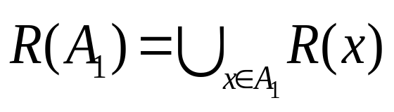
R-relative Set
If R is a relation from set A to B
  For any x∈A, R-relative set of x, R(x) is:
  {y|y∈B, xRy} (this is a subset of B)
  For any A₁⊆A, R-relative set of R(A₁) is:
  {y|y∈B, there exists some x∈A₁ such that xRy}
  Note that:

Slide 13
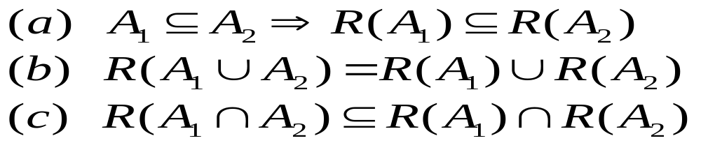
Properties of R-relative Sets
Let R be a relation from A to B, A₁, A₂ be subsets of A, then:
Proof of (c): for any y∈R(A₁∩A₂), then there exists some x in A₁∩A₂ such that xRy. So, x∈A₁, x∈A₂. It follows that y∈R(A₁) and y∈R(A₂), thus y∈R(A₁)∩R(A₂).
Equality doesn’t hold. Counterexample: considering relation “≤” on Z, A₁={0,1,2}, A₂={9,13}, R(A₁) is the set of all nonnegative integers, and R(A₂) is the set of integers not less than 9, so, R(A₁)∩R(A₂)={9,10,11,12,...}, but A₁∩A₂=φ, which results R(A₁∩A₂)=φ .

Slide 14

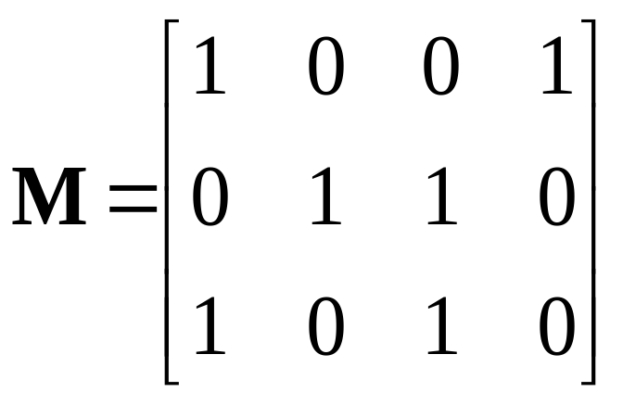
Representing Relations as Matrices
A={a₁, a₂, a₃}
B={b₁, b₂, b₃, b₄}
R={(a₁, b₁), (a₁, b₄),
(a₂, b₂), (a₂, b₃),
(a₃, b₁), (a₃, b₃)}
b₁ b₂ b₃ b₄
a₁
a₂
a₃
(a_{i}, b_{j})∈R if and only if:
m_{i,j}=1

Slide 15
Representing Relations as Digraphs
Digraph representation is used only for relations on one set.
A={1,2,3,4}
R={(1,1), (1,2), (2,1),
(2,2), (2,3), (2,4),
(3,4), (4,1)}
2
1
3
For node 1, the in-degree is 3, out-degree is 2
4

Slide 16
Path in Digraph
A path of length n in R from a to b is a finite sequence π: a, x₁, x₂,..., x_{n-1}, b, such that: aRx₁, x_{n-1}Rb, and x_{i}Rx_{i+1} for i=1,...n-2
A path in R corresponds to a succession of edges in the digraph representation of the relation, which consists of n edges.
It is not required that all elements in a, x₁, x₂,..., x_{n-1}, b are distinct.

Slide 17
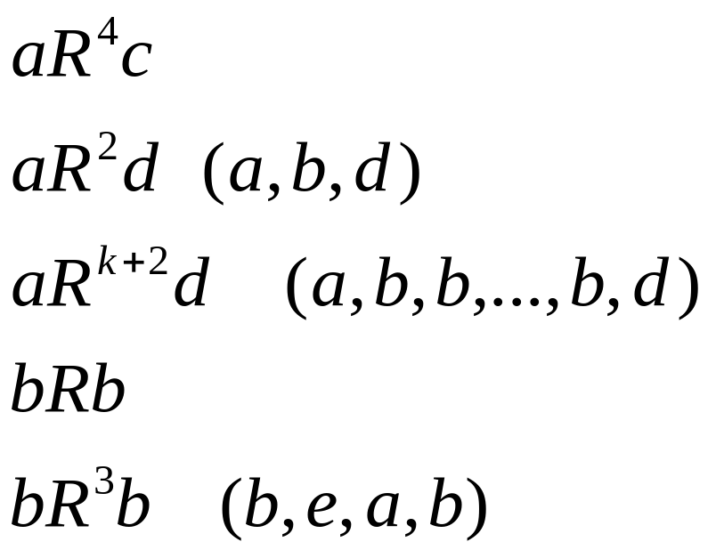

New relations defined using Paths
π₃
k+1 b’s
a
b
π₁
c
e
d
π₁: a, b, e, d, c length: 4
π₂: a, b, e, a length: 3(cycle)
π₃: b, b length: 1(ring)
Generalized(connctivity):
xR∞y if there is a path of any length from x to y.

Slide 18

New relations defined using Paths
a
b
R²={(a,b), (a,c), (a,d), (a,e), (b,a), (b,b),
(b,c), (b,d), (b,e), (e,b), (e,c)}
R³={(a,a), (a,b), (a,c), (a,d), (a,e), (b,a),
(b,b), (b,c), (b,d), (b,e), (e,b), (e,e)}
R∞ ={(a,a), (a,b), (a,c), (a,d), (a,e), (b,a),
(b,b), (b,c), (b,d), (b,e), (d,c),
(e,a), (e,b), (e,c), (e,d), (e,e)}
c
e
d
Digraph of R

Slide 19
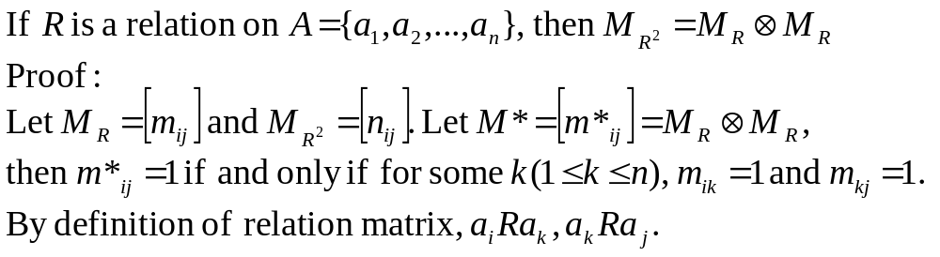
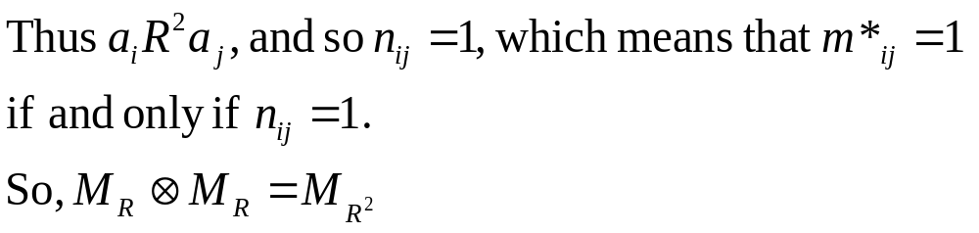
R² by Matrix Multiplication

Slide 20
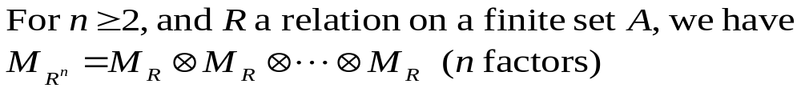
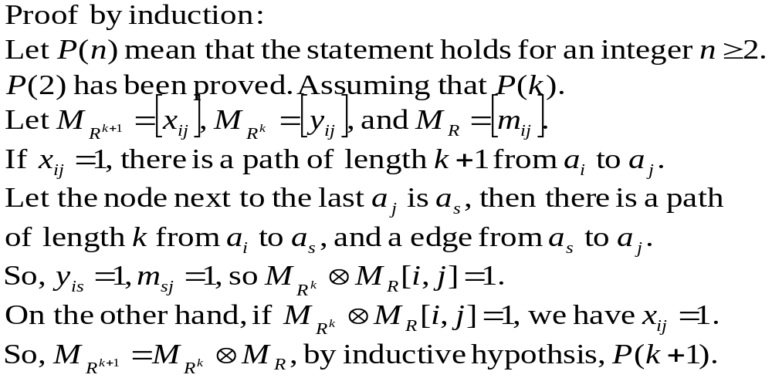
R^{n} by Matrix Multiplication

Slide 21
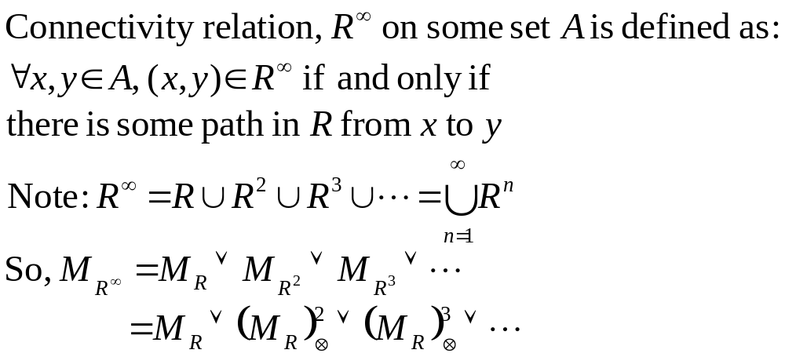
Connectivity Relation
What is R∞(A₁)?

Slide 22
Reflexivity
Relation R on A is
  Reflexive if for all a∈A, (a,a)∈R
  Irreflexive if for all (a,a)∉R
Let A={1,2,3}, R⊆A×A
  {(1,1),(1,3),(2,2),(2,1),(3,3)} is reflexive
  {(1,2),(2,3),(3,1)} is irreflexive
  {(1,2),(2,2),(2,3),(3,1)} is neither reflexvie nor irreflexive.
R is reflexive relation on A if and only if I_{A}⊆R

Slide 23
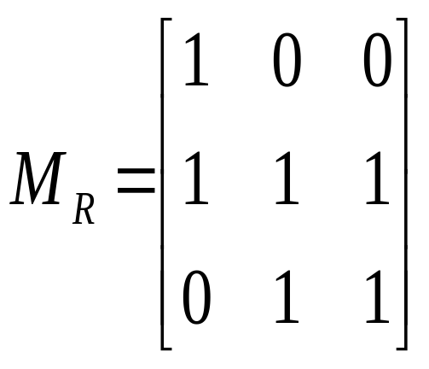
Visualized Reflexivity
A={a,b,c}
a
b
c

Slide 24
Symmetry
Relation R on A is
  Symmetric whenever (a,b)∈R, then (b,a)∈R
  Antisymmetric if whenever (a,b)∈R and (b,a)∈R then a=b.
  Asymmetric if whenever (a,b)∈R then (b,a)∉R
  (Note: neither anti- nor a-symmetry is the negative of symmetry)
Let A={1,2,3}, R⊆A×A
  {(1,1),(1,2),(1,3),(2,1),(3,1),(3,3)} is symmetric.
  {(1,2),(2,3),(2,2),(3,1)} is antisymmetric.
  {(1,2),(2,3),(3,1)} is antisymmetric and asymmetric.
  {(11),(2,2)} is symmetric and antisymmetric.
  φ is symmetric and antisymmetric, and asymmetric!
R is symmetric relation on A if and only if R⁻¹=R

Slide 25
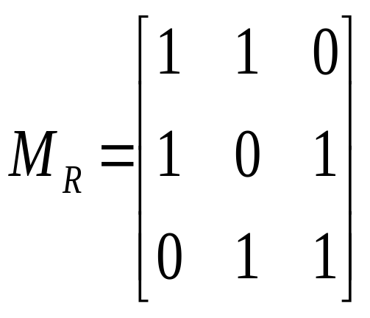
Visualized Symmetry
A={a,b,c}
a
b
c

Slide 26
Transitivity
Relation R on A is
  Transitivity if whenever (a,b)∈R, (b,c)∈R, then (a,c) ∈R
Let A={1,2,3}, R⊆A×A
  {(1,1),(1,2),(1,3),(2,1),(2,2),(2,3),(3,3)} is transitive
  {(1,2),(2,3),(3,1)} is not transitive.
  Both {(1,3)} and φ are transitive.
R is transitive relation on A if and only if R^{n}⊆R for all n≥1

Slide 27
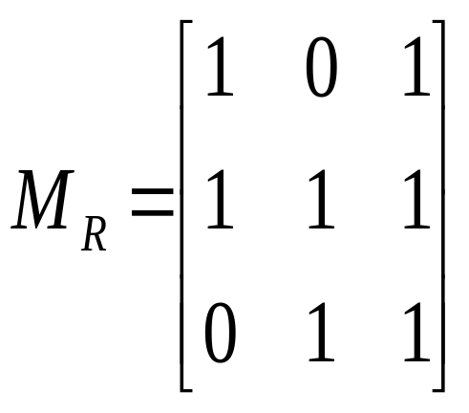
Visualized Transitivity
A={a,b,c}
a
b
c

Slide 28
Some Often Used Relations
 | = | ≤ | < | | | ≡₃ | φ | E
reflexivity |  |  |  |  |  |  | 
irreflexivity |  |  |  |  |  |  | 
symmetry |  |  |  |  |  |  | 
antisymmetry |  |  |  |  |  |  | 
transitivity |  |  |  |  |  |  | 

Slide 29
What’s Wrong?
A wrong proof: if R is a symmetric and transitive relation on A, then R must be reflexive.
  Proof:
  For any a,b∈A, if (a,b)∈R, by the symmetry of R, (b,a)∈R; since R is transitive, (a,a)∈R. So, R is reflexive.

Slide 30
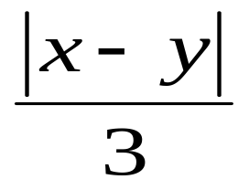
Equivalence Relation
Relation R on A is an equivalence relation if and only if it is reflexible, symmetric and transitive.
“Equility” is a special case of equivalence relation.
An example:
  R⊆Z×Z, (x,y)∈R if and only if is integer, i.e. x≡y (mod 3)

Slide 31
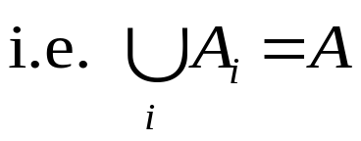
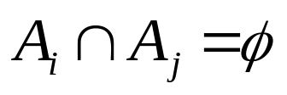
Partition of a Set
A partition of a set A, π, is a set of the nonempty subsets of A. (so, π⊆ρ(A), satisfying:
1. For any x∈A, there is some A_{i}∈π, such that x∈A_{i}.
A
A₆
A₁
A₅
A₂
A₄
2. For any A_{i}, A_{j}∈π, if i≠j, then:
A₃

Slide 32

Partition Generated by Equivalence
Equivalence class:
  Let R is a equivalence relation on A, then given a∈A, R(a) is a equivalence class induced by R.
Quotient set:
  Q={R(x)|x∈A, and R is a equivalence on A}
Quotient set is a partition:
  For any a∈A, a∈R(a) (remember that R is reflexible)
  For any a,b∈A
    (a,b) ∈R if and only if R(a)=R(b), and
    (a,b) ∉R if and only if R(a)∩R(b)=φ

Slide 33
Equivalence induced by Partition
Given a partition on A, we can define a relation R on A as following:
∀x,y∈A, (x,y)∈R if and only if:
x,y belong to the same block.
Ex. (x,y)∈R (y,z)∈R (x,z)∈R (x,x)∈R etc.
A
A₆
A₁
A₅
A₂
x
A₄
It is straight to prove that R is reflexible, symmetric and transitive, so, it is an equivalence relation.
y
z
A₃

Slide 34
An Example of Equivalence
R₁,R₂ are equivalences defined respectively on sets X₁ and X₂. Define relation S on X₁×X₂ as follows:
<x₁,x₂>S<y₁,y₂> if and only if x₁R₁y₁ 且 x₂R₂y₂
Then, S is also a equivalence, defined on X₁×X₂.
  Reflexivity: for any <x,y>∈X₁×X₂, since both R₁,R₂ are reflexive, <x,x> ∈R₁, <y,y> ∈R₂; ∴<x,y>S<x,y>;
  Symmetry: assume that <x₁,x₂>S<y₁,y₂>, which means that x₁R₁y₁ and x₂R₂y₂, so, y₁R₁x₁ and y₂R₂x₂, because of the symmetry of R₁ and R₂. So, <y₁,y₂>S<x₁,x₂>;
  Transitivity: assume that <x₁,x₂>S<y₁,y₂>, and <y₁,y₂>S<z₁,z₂>, then x₁R₁y₁, y₁R₁z₁, x₂R₂y₂, y₂R₂z₂. Since both R₁ and R₂ are transitive, we have: x₁R₁z₁, 且x₂R₂z₂, so, <x₁,x₂>S<z₁,z₂>.

Slide 35
Another example
Prove:
Among any 1001 difference numbers randomly selected from the subset of natural numbers {1,2,...,2000} must be two, x,y，satisfying x/y=2^{k}.
(k is an integer)

Slide 36
The Proof
Create 1000 sets, each cantain a unique odd integer between 1 and 2000, along with its multiplication of 2^k not greater than 2000.
Prove that the set of the 1000 sets is a partition of the set {1,2,...,2000}.
Note that, for any positive integer, x,y between 1 and 2000, they belong to the same set if and only if x/y=2^{k}. (k is an integer)。
Define a relation R on {1,2,3,..., 2000}: for any x,y in the set，xRy if and only if x/y=2^{k}. It is easy to prove that it is an equivalence, and the associated quotient set if the partition above.

Slide 37
Home Assignments
To be checked
  p.114: 6;9;15;18;24;30-31, 33-38
  p.122: 18-19; 25-26; 28, 32, 36
  p.128: 18-21; 27; 30-33
  p.134: 14, 16, 18, 20, 22, 31-36
  p.139: 19, 22-24, 27-29
Self tests

